Slide 1

Comp2200 presentation
Group members:
- Quang Huy Ha (44498535)
- Khanh Linh Pham (45483736)
- Ehtesam Fayek Utsho (44469357)
- Nguyen Minh Hanh Do (45524866)

Slide 2
Introduction
Main Problem Statement:
Is Money the only determinant of Happiness?

Slide 3
Data source
3 sources:
Happiness Score: Gallup World Poll
Human Freedom Index: Cato Institute
Emission: Our World in Data – based at Oxford University
Original Study: ​
Carried out by Sustainable Development Solutions Network (SDSN)
Focused on the link between sustainable development and human well-being
Our Project: Address the controversial discussion:
“Is money the only determinant of happiness?”

Slide 4
Data Cleaning
1. Cleaning raw data
Three data sets:
- CO2 emission data from before 2000 to 2018
- Happiness score data from 2015 to 2019
- Human Freedom data from 2015 to 2017
2. Filtering cleaned data
When working with data, all datasets are merged as one set. The non-numerical values are also filtered for the later purposes of data exploration as well as regression.
Cleaning:
- Only take data from 2015 to 2017 cross all 3 data sets to ensure we have sufficient data for analysis
- Removing countries with less than 3 records from 2015 to 2017
- Exporting as cleaned data

Slide 5

Methods used
Data exploration using correlation
Clustering:
Hierarchical cluster to find number of clusters
K-means to find the data categories
Regressions
Linear Regression
Lasso Regression
RandomForest Regression

Slide 6
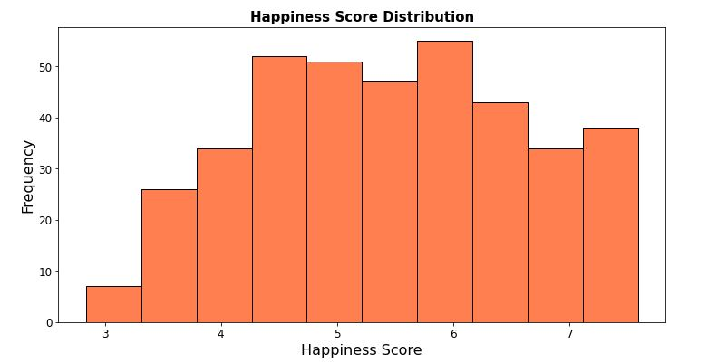
Data exploration
Happiness Score is Normally Distributed

Slide 7
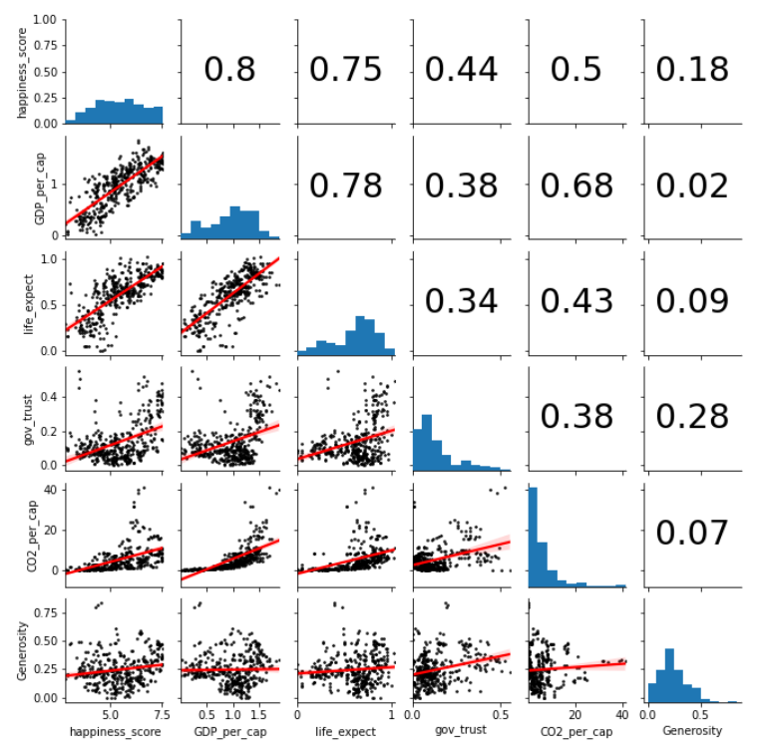
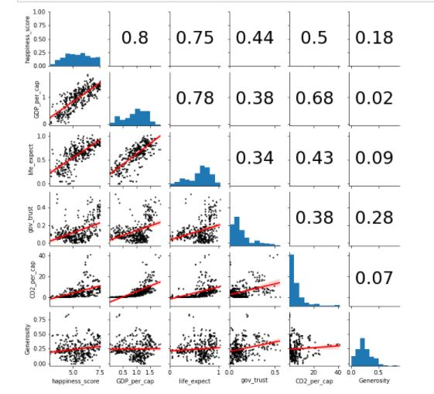
Pair plot
showing relation between happiness score and other factors which include GDP per capita, life expectancy, government trust, carbon-di-oxide emission per capita and generosity of a country.
1 represent the strongest relation whereas 0 being the weakest.
It is clear from the pair plot that happiness score has the strongest relation with GDP and the weakest relation with Generosity.

Slide 8
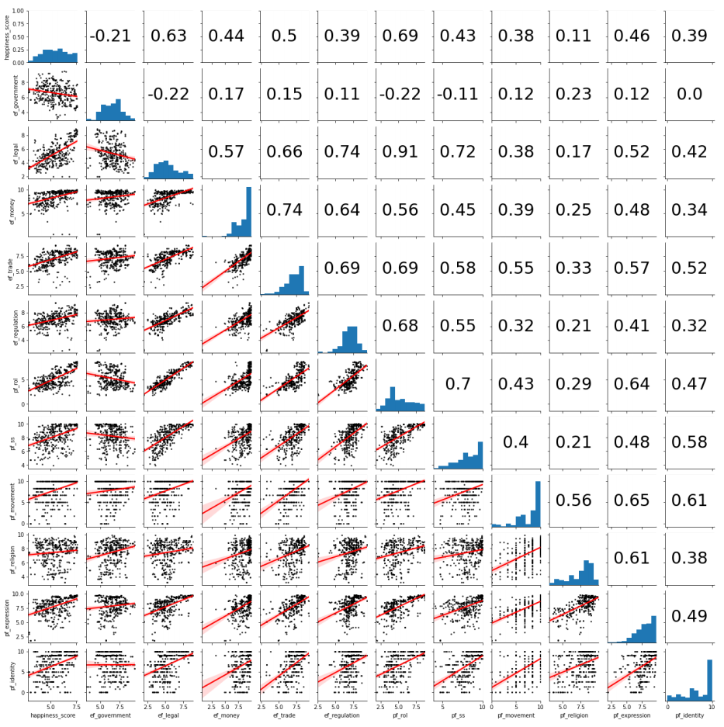
Pair plot
showing relation between happiness score and all other factors.
1 represent the strongest relation whereas 0 being the weakest.
It is clear from the pair plot that happiness score has the strongest relation with Rule of law (pf_rol) and the weakest relation with Size of Government (ef_government).

Slide 9
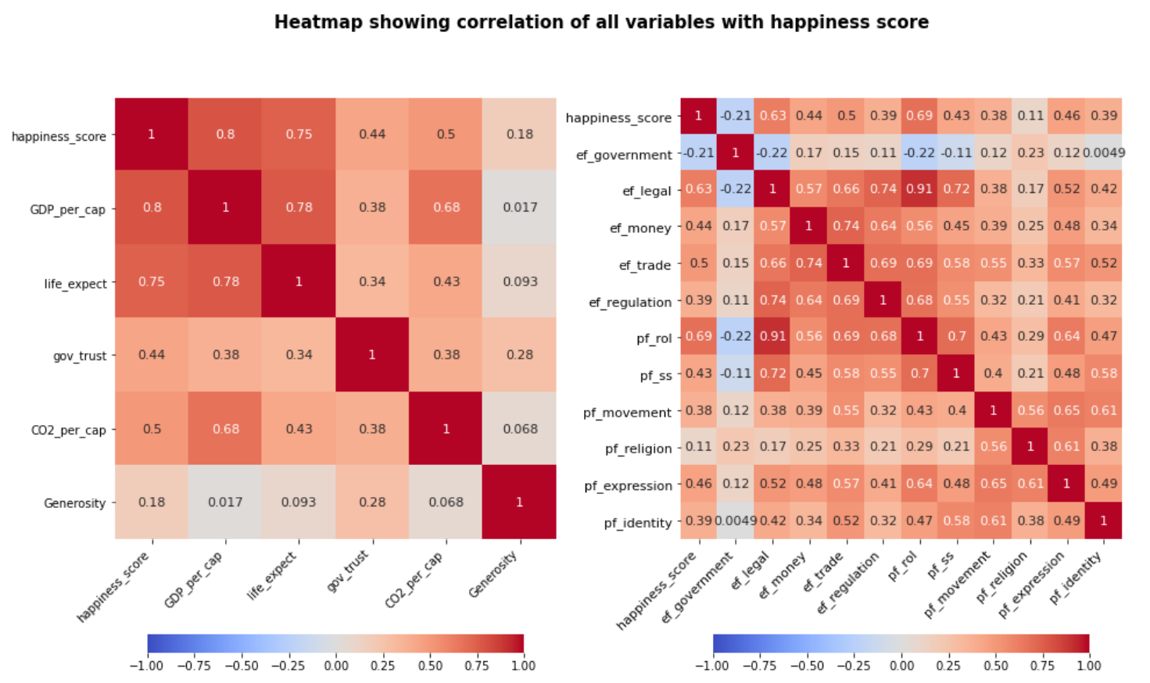
Heat map Correlation
Heatmap Interpretation Note:
Positive linear relationship: the darker the red (where correlation is closer to 1), the stronger the positive relationship.
Negative linear relationship: the darker the blue (where correlation is closer to 1), the stronger the negative relationship.
Neutral relationship: the color is white/almost white (where the correlation is relatively 0). This means 2 variables are not related, or barely related to each other.

Slide 10
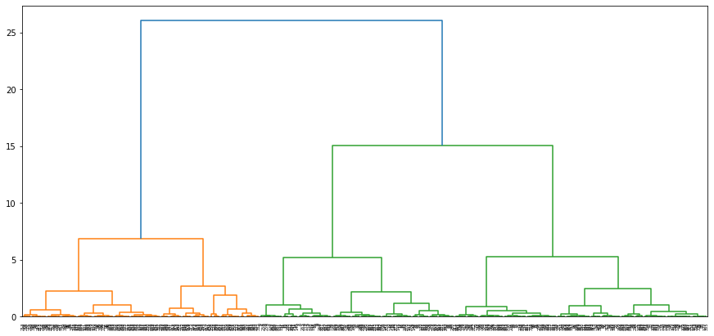
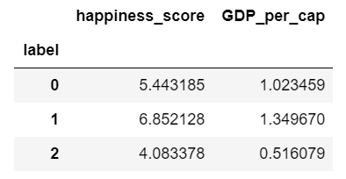
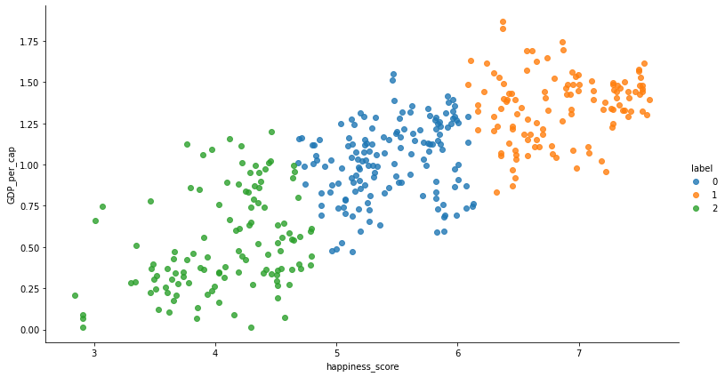
Data Clustering
1. Hierarchical clustering
Clustering method used:
- Hierarchical clustering
- K_Means clustering
3 categories of happiness scores:
- Low (approximately 3 - 4.5)
- Medium (approximately 4.5 - 6)
- High (approximately 6 - 7.5)
2. K_Means clustering

Slide 11
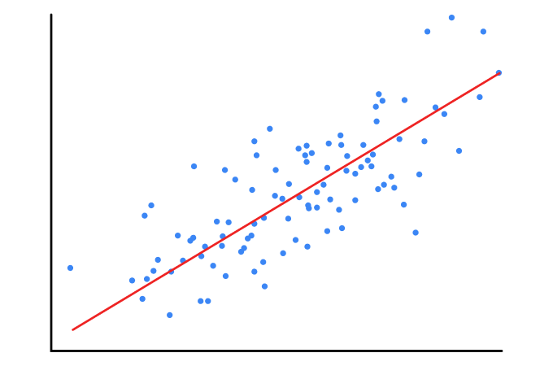
Regression Analysis
Regression models used:
- Linear Regression
- Lasso Regression
- Random Forest Regression
Steps of execution for each regression
- Using regression method with only money factor to predict happiness
- Using all variables to predict happiness
- Using RFE and cross-validating to find the best number of variables
- Using parameter tuning for best variable to try get the highest scores

Slide 12
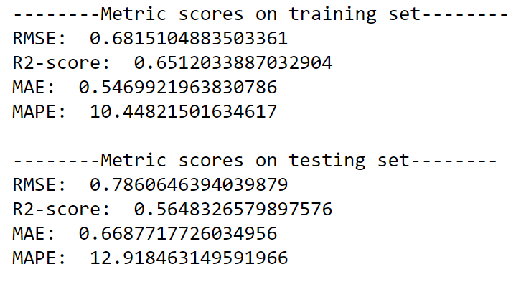
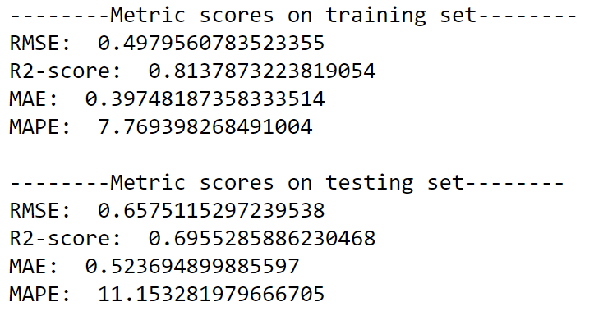
Linear regression
Prediction using money factor vs using all factors:
For linear regression, we first try to predict the happiness scores using money factor only, GDP_per_cap. (figure 1) and then Use all variables to predict happiness in figure 2.
Figure L1: predict on train and test set using only GDP_per_cap
- L1: Underfitting
- L2: Less underfitting (or no longer underfitting)
=> An improvement when using all variables
Figure L2: predict on train and test set using all variables

Slide 13
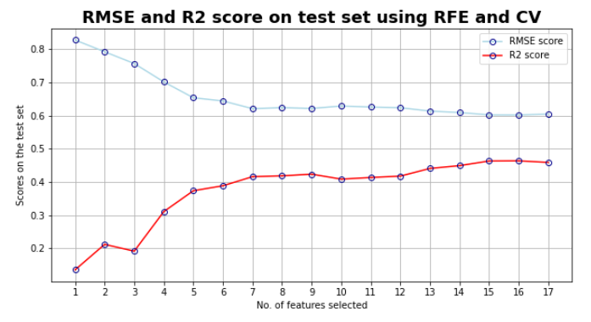
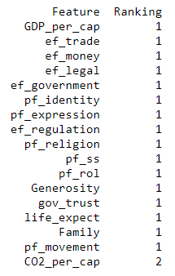
Linear regression
In
Find the best features:
- Find the number of features that give the highest R2 scores and lowest RMSE score using Recursive Feature Elimination (RFE) and cross-validation (CV)
- Figure L3 shows the best combination is 16 features, which give the highest R2 score and lowest RMSE score
Figure L3: Using RFE and Cross-validation to find the best number of features using RMSE and R2
- Figure L4 shows the ranking of all features with ranks number 1 means they are the selected features while rank 2 means the eliminated one
Figure L4: Ranking the features based on the contribution toward R2 and RMSE scores in L3 figure

Slide 14
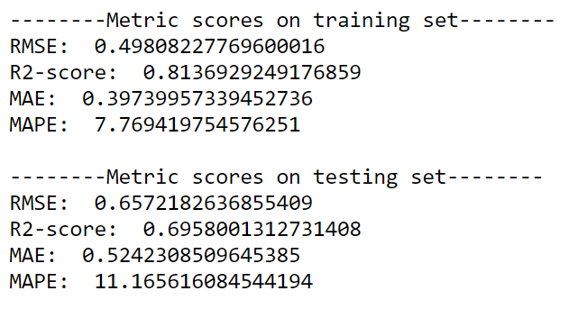
Linear regression
Using 16 features to predicts happiness score and compare with all features-prediction.
Observation:
- The test results had some improvement
- The improvements are not significant
- Changes on all scores only at second or third decimal places
Figure L2: predict on train and test set using all variables
Figure L5: predict on train and test set using best 16 features

Slide 15
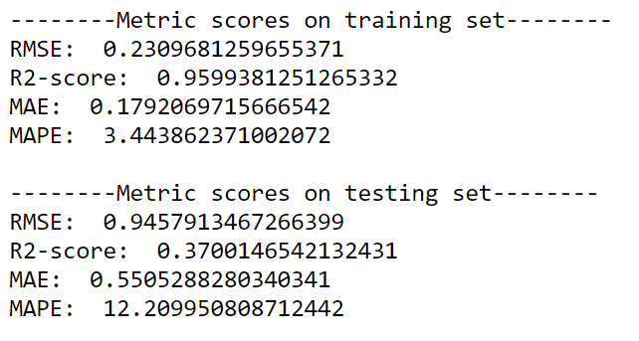
Linear regression
Using polynomial features to tune all 16 features:
- Polynomial feature intake each entry of X_test and transform into multiple entries of linear regression model to create a smooth curve
- The regression line becomes a curve which describe the dataset better
Figure L5: predict on train and test set using best 16 features
Observation:
- The prediction on train set improve significantly with low RMSE, MAE, MAPE and high R2 (figure L6)
- The prediction on test model performs worse that before tuning the features.
- The model is overfitting
Reason for the worse performance:
- The degree for polynomial might not be correct (currently using default value degree = 2)
- There might exist outliers and polynomial regression is very sensitive.
Figure L6: predict on train and test set using best 16 features after using parameter tuning

Slide 16
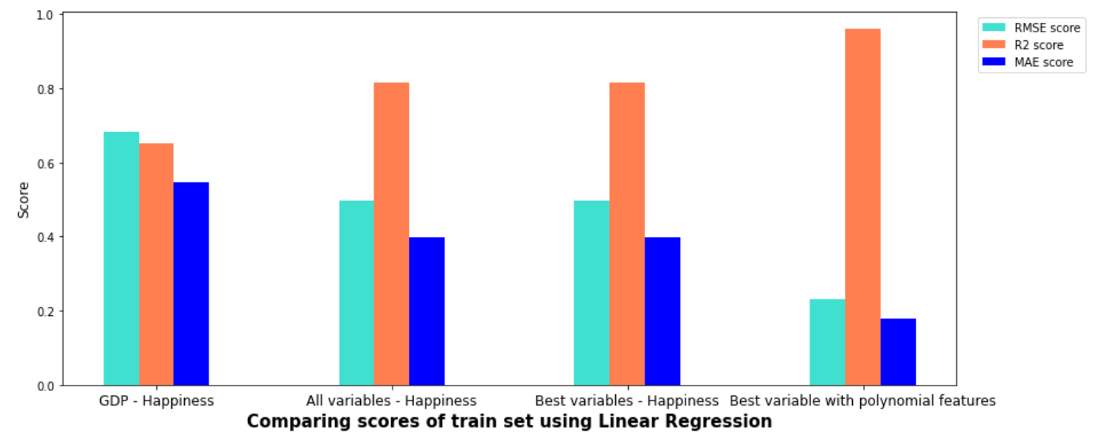
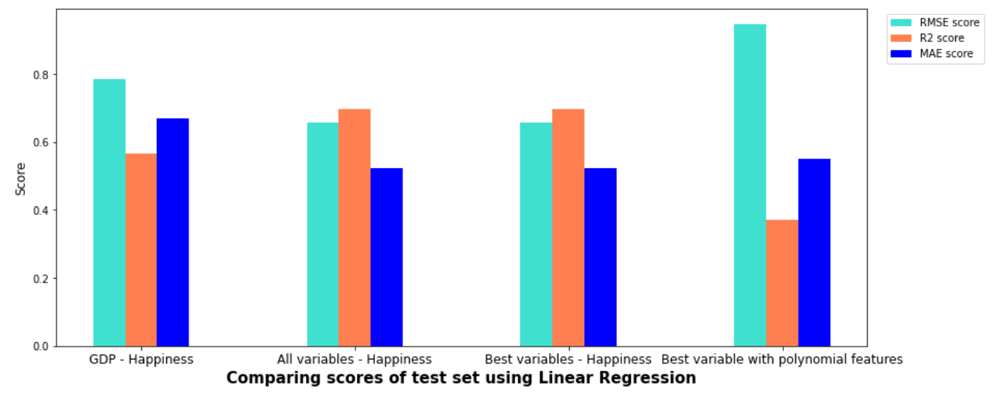
Linear regression
Comparing all predictions
On train set:
- The best performance is using 16 variables with parameter tuning polynomial features.
- All variables and 16 variables (no tuning) have the similar performance on prediction
On test set:
- 16 variables with parameter tuning polynomial features has the worst performance
- All variables and 16 variables (no tuning) have the similar performance on prediction, and they have the best performance
Figure L7: Graph comparing scores of different prediction method on train set
Conclusion:
- 16 variables (no co2 emission) without tuning has the best performance on prediction, i.e. they are the most 16 important features to determine the happiness score
- At the same time, all combination of all 17 features has a very similar results to 16 variables with a very minimum difference
Figure L8: Graph comparing scores of different prediction method on test set

Slide 17
Linear regression
Should we choose 16 or 17 features to be the important determinants for happiness score?
Look at different Regression Models to confirm the number of chosen features!!

Slide 18
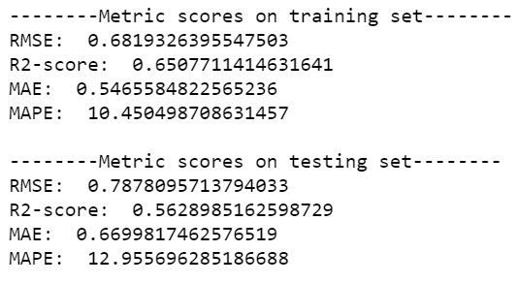

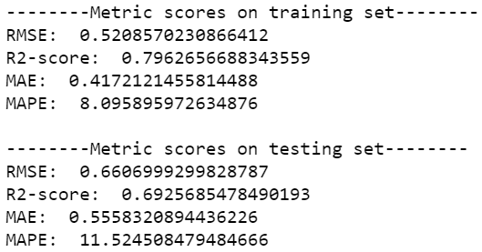
Lasso regression
1. Only GDP_per_cap
For GDP_per_cap only:
- Only 56% of variations is explained.
- The model is somehow overfitting.
- Happiness score is predicted to increase 2.176 when the GDP_per_cap increases by one.
2. All variables
For all variables:
- 69% of variations is explained.
- RMSE score is also decreased from 0.78 to 0.66.
- Metric scores have improved significantly.

Slide 19
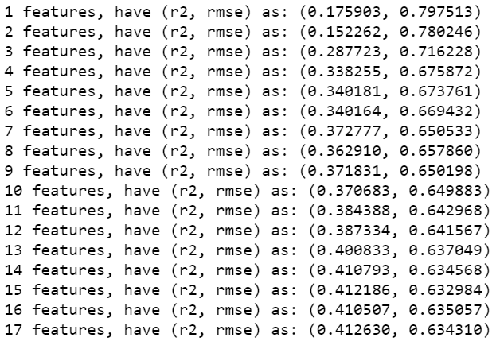
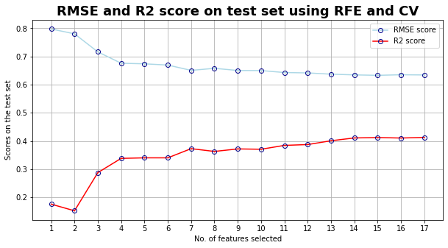
Lasso regression
3. RFE & Cross
Validation
Using RFE & Cross Validation to find number of important features
- R2 score has the best result (I.e. 0.412) using 17 features.
- The point of R2 score with 17 features is also the lowest on the graph.
4. Plot RMSE &
R2 score
17 important features will be selected.

Slide 20
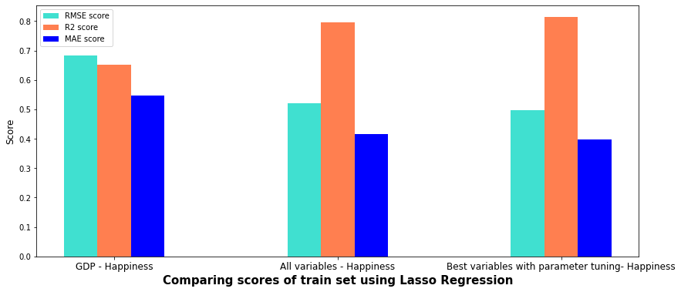
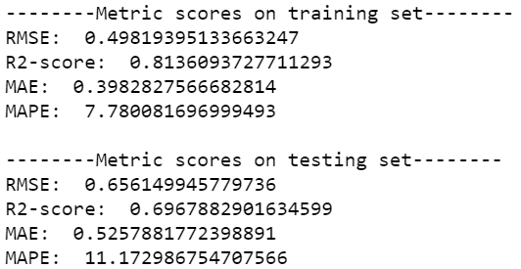
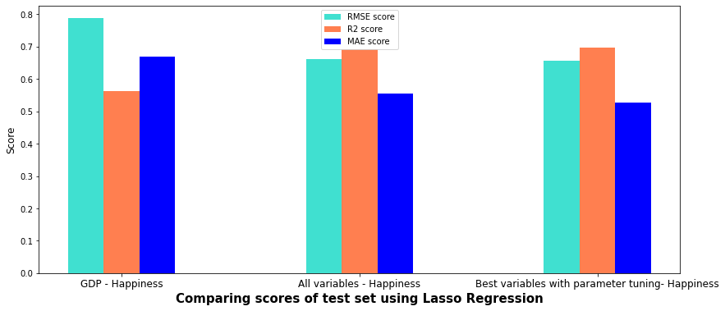
Lasso regression
Comparing all train – test sets for Lasso regression
Parameter tuning using GridSearchCV
The metric scores are slightly improved now with R2 score increases from 0.6925 to 0.6967 now.
Scores are much better for "Best variables - Happiness" groups:
- R2 score: higher in All/ Best variables.
- RMSE score: lower in All/ Best variables.

Slide 21

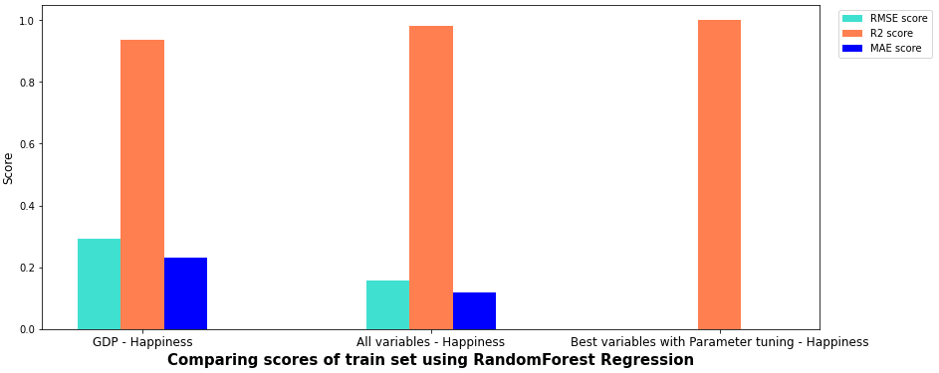
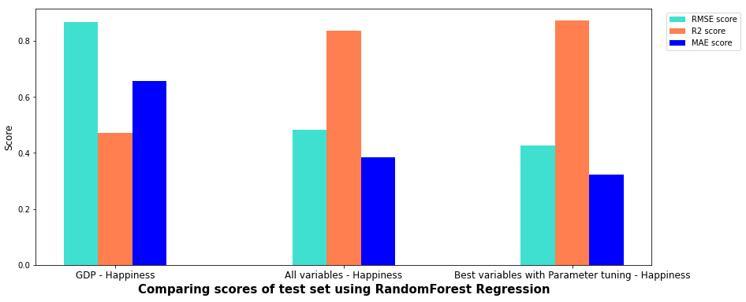
RANDOM FOREST rEGRESSION
TRAIN set RESULT
First, only GDP_per_cap (money factor) is used to predict happiness score.
Then, we try to improve the model by adding all valid variables to predict happiness score. The model improves significantly with less overfitting and better metric scores
TEST set RESULT
Finally, we use RandomizedSearchCV for parameter tuning to find out the best set of hyperparameters for the Random Forest Regression model. This model performs best among the three models

Slide 22
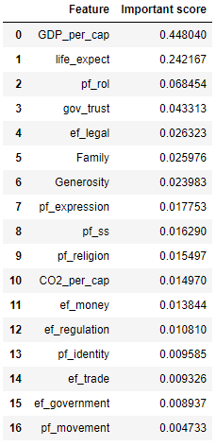
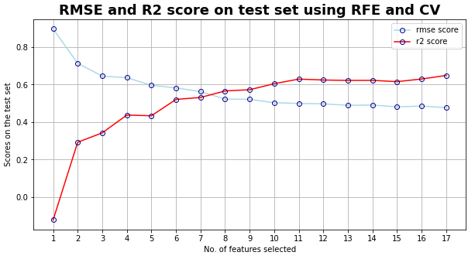
Random forest regression fEATURE iMPORTANCE
FEATURE IMPORTANCE RANKING
RFECV is used to find the features that will lead to the optimal results when Random Forest Regression is applied on the data
All 17 features should be applied to produce the most optimal result (highest R2 Score, lowest RMSE)

Slide 23
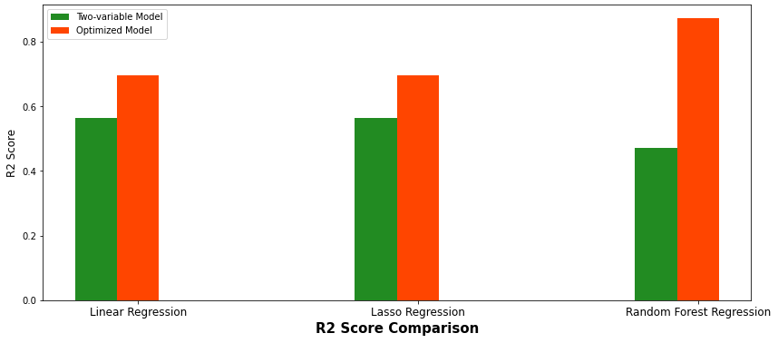
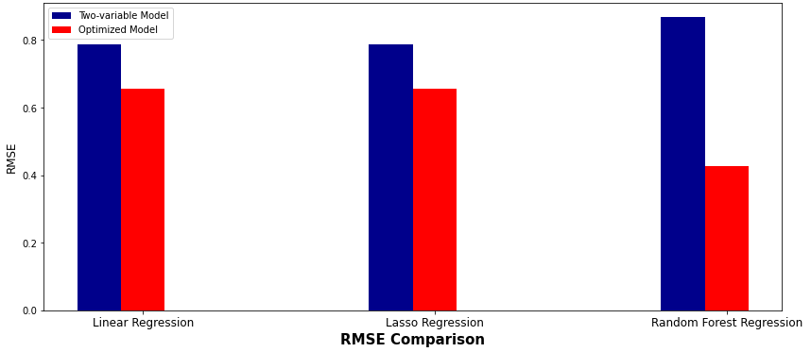
MODEL cOMPARISON
R2 sCORE BASED COMPARISON
Using selected features that are recommended by the RFECV to predict happiness score produces higher R2 score and lower RMSE results compared to using only money factor to predict happiness score
Based on both R2 Score and RMSE, Random Forest Regression with RFECV-recommended features is the most optimal model, with highest R2 Score, lowest RMSE score, then comes Lasso Regression and finally Linear Regression
RMSE BASED COMPARISON

Slide 24

conclusion
In order to answer the controversial question: "Is money the only determinant of Happiness?", the project has worked on Data Cleaning, Data Exploration, Clustering, and applied 3 main types of Regression models on the dataset
After critical analysis, we find out models with more variables as the predictor of happiness score are more efficient than models using only money as the sole determinant. This implies people possessing money and other lives factors are happier than those who only have money
Answer: ​
Money is not the only determinant of happiness score

Slide 25

Thank you

